Slide 1

Boston Housing Price Prediction
By
m.Logashri
Team 7

Slide 2
Introduction
The project aims to predict housing prices based on influential factors like:
Number of rooms
Crime rate
Land area
Utilizes Machine Learning models like Linear Regression and Ridge Regression.
Predictions are provided in Indian Rupees (INR) for better usability.
Aims to assist buyers, sellers, and policymakers in informed decision-making.

Slide 3
Problem Statement
Real estate pricing is influenced by multiple factors such as crime rate, number of rooms, and location.
Accurate price prediction is crucial for:
Investment decisions
Fair pricing strategies
Market analysis
Objective: Build a model that provides accurate and interpretable price predictions.

Slide 4
Technologies Used
Programming Language: Python
Libraries/Frameworks:
Machine Learning Libraries:
scikit-learn: Model building, hyperparameter tuning, and evaluation
Data Manipulation Libraries:
pandas: Data processing and manipulation
numpy: Numerical operations and array handling
Data Visualization Libraries:
matplotlib: Basic data visualizations
seaborn: Advanced visualizations (e.g., heatmaps, regression plots)
This combination of libraries ensures efficient data preprocessing, robust model building, and clear visualization outputs for better interpretability and decision-making.

Slide 5
Dataset Overview
Source: California Housing Dataset (used as a substitute for Boston Housing).
Key Features:
Number of rooms
Crime rate (CRIM)
Number of bedrooms & bathrooms
Land area
Location coordinates (Latitude & Longitude)
Target Variable: Housing Price

Slide 6
Methodology
Data Collection & Preprocessing:
Handling missing data
Standardization and normalization
Feature Engineering:
Added new fields (e.g., bedrooms, bathrooms, crime rate)
Model Building:
Linear Regression
Ridge Regression with hyperparameter tuning
Model Evaluation:
Mean Squared Error (MSE)
R-squared (R²)

Slide 7
Data Visualization
Correlation Heatmap: Key features affecting house prices.
Prediction Plot: Actual vs Predicted Prices.
Feature Importance Analysis: Insights into influencing factors.
Challenges Faced
Handling missing data and outliers.
Avoiding overfitting in regression models.
Ensuring scalability for larger datasets.

Slide 8
Benefits of the House Price Prediction
Accurate Price Predictions:
Provides reliable housing price estimates based on multiple influential factors like the number of rooms, crime rate, and land area.
Data-Driven Insights:
Identifies key features impacting housing prices, helping stakeholders understand market trends better.
User-Friendly Interface:
Allows users to input property details (e.g., rooms, bathrooms, crime rate) and receive accurate predictions in Indian Rupees (INR).
Informed Decision-Making:
Assists buyers, sellers, and investors in making strategic real estate decisions.

Slide 9
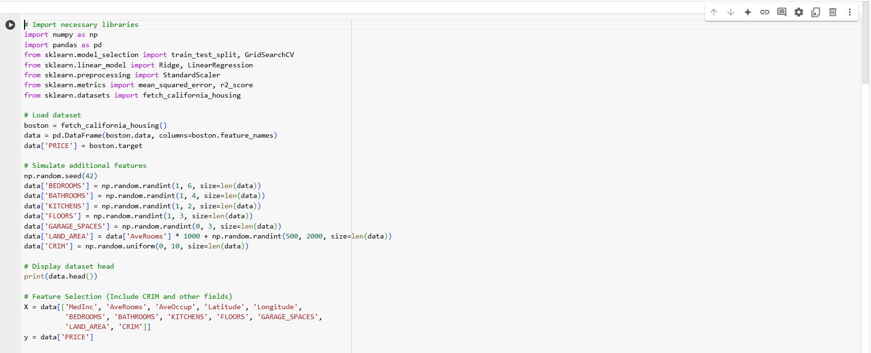
CODE

Slide 10
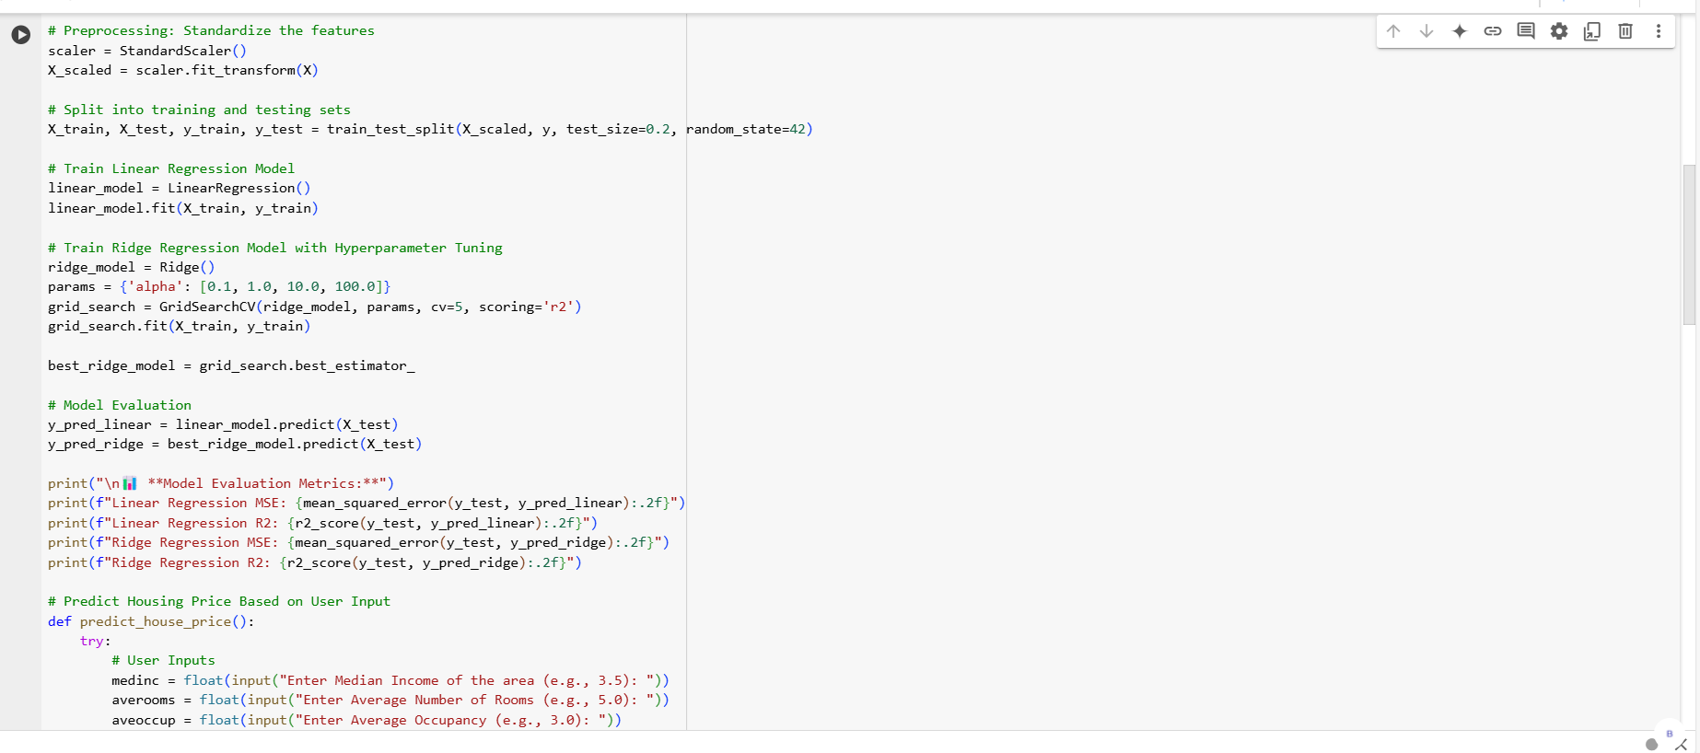

Slide 11
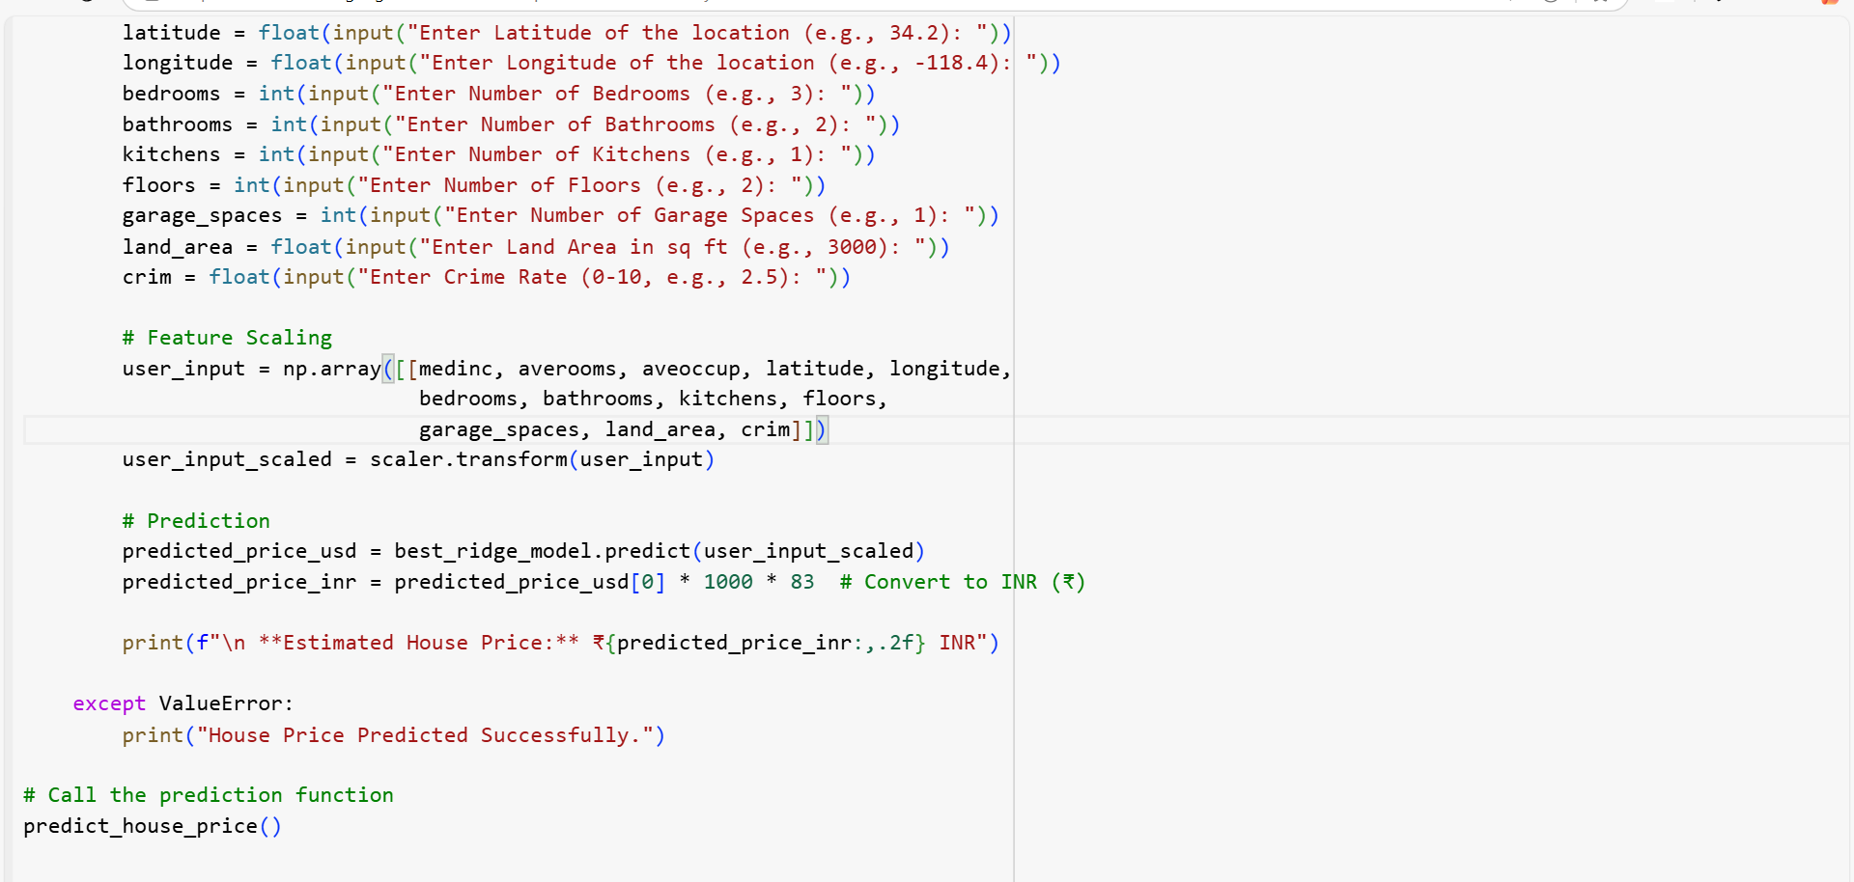

Slide 12
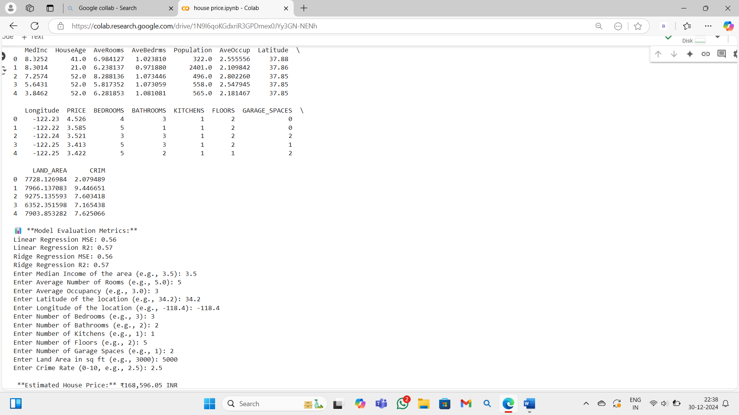
OUTPUT:

Slide 13
THANK YOU!

